Slide 1


G4U
BUILDING PERFORMANCE
Building Performance, Proven.
AI + engineering
for better building
performance
Reduce energy waste. Improve everyday operation. Sustain the results.
AI Energy Management
Retrofit Engineering
Managed Performance
Illustrative building scene
Notes:
We help existing buildings use less energy and operate better. G4U connects AI energy management, engineering improvement and long-term performance management. Which operating or energy issue matters most for your building? Cover image: illustrative office-building scene.

Slide 2
G4U
BUILDING PERFORMANCE
Energy waste can hide in everyday operation
Small operating changes accumulate across schedules, cooling systems and equipment.
After-hours operation
Cooling continues when the building or zone is largely unoccupied.
Cooling efficiency drift
Plant staging, setpoints and part-load operation move away from efficient conditions.
Unresolved operating issues
Meter data, comfort complaints and equipment information are reviewed separately.
Find the operating cause, choose an action and verify its effect.
G4U Technical Services L.L.C.
02
Notes:
Start with one operating issue the customer recognizes. Compare the energy pattern with the operating cause, then connect it to an action and a performance check.

Slide 3
G4U
BUILDING PERFORMANCE
One service connects data, decisions and delivery
The AI system, engineering work and managed performance share one improvement plan.
AI Energy Management
Retrofit Engineering
Managed Performance
Measure, investigate and prioritize opportunities.
Commission, optimize and improve the building's systems.
Track outcomes, tune operation and plan the next improvement.
A repeatable cycle: measure, diagnose, improve and assure.
G4U Technical Services L.L.C.
03
Notes:
The three services share one improvement plan. Digital investigation identifies the opportunity, engineering delivers the measure, and managed service keeps reviewing the result. Existing systems and the owner’s operating team remain part of the delivery model.

Slide 4
G4U
BUILDING PERFORMANCE
Coordinated action has delivered measurable value
Selected anonymous reference projects connect digital capability with building operation.
Corporate headquarters
Large commercial complex
13.3%
23%
Annual electricity savings
Average HVAC energy savings
Integrated smart-building and energy-management applications.
Central HVAC optimization and coordinated system operation.
G4U Technical Services L.L.C.
04
Notes:
Source: anonymous project operating records. The corporate-headquarters result is 13.3% annual electricity savings. The commercial-complex result is 23% average HVAC energy savings. The two metrics have different scopes. Which operating setting is closer to this building?

Slide 5
G4U
BUILDING PERFORMANCE
Begin with the systems your team can improve
The first project focuses on owner-controlled HVAC and common building services.
01
Cooling plant or district-cooling interface
Agreed building performance boundary
02
Air handling, pumping and ventilation
03
Common-area schedules and metering
Measurable systems
Agreed operating authority
04
Relevant indoor-environment and equipment data
Tenant-controlled areas can be considered later under a separately agreed scope.
G4U Technical Services L.L.C.
05
Notes:
Confirm the cooling supply and the systems the owner controls. Begin with a measurable HVAC and common-services boundary. Tenant-controlled areas can be considered separately when their operating authority and measurement scope are agreed.

Slide 6
G4U
BUILDING PERFORMANCE
Ask a question. Follow the evidence to an action.
“Why is cooling energy staying high after office hours?”
Compare
Investigate
Act
Verify
Review energy trends, weather, occupancy and schedules.
Use engineering rules and analytical models to test likely causes.
Prepare a prioritized operating or engineering recommendation.
Check the energy effect, indoor conditions and equipment operation.
Workflow example with illustrative operating data
G4U Technical Services L.L.C.
06
Notes:
Use the offline workflow example to follow one question through evidence, analysis, recommendation and verification. Engineering rules and analytical tools test causes; an AI assistant helps connect and explain the evidence. Example data illustrates the workflow.

Slide 7
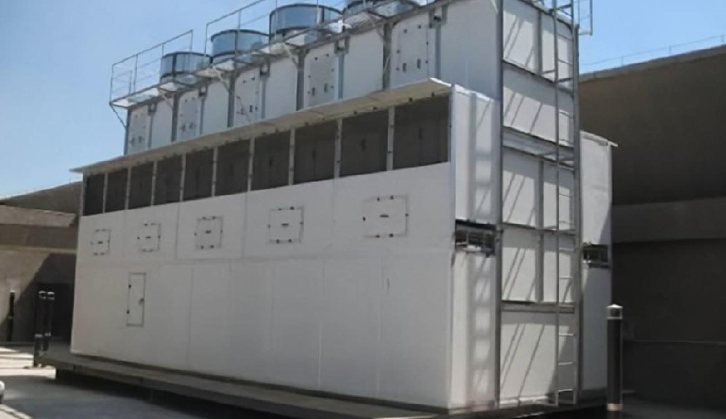
G4U
BUILDING PERFORMANCE
Engineering turns insight into site improvement
Choose the measures that address the actual cause of waste.
Improve operation
Schedules, staging, setpoints, balancing and commissioning.
Improve equipment
Chiller and plant upgrades, variable-speed drives, metering and controls.
Improve the building
Insulation, envelope improvements and other suitable technologies.
Cooling-system fieldwork
G4U Technical Services L.L.C.
07
Notes:
Select measures after understanding the site: operating improvements, equipment modernization and suitable building measures. Delivery includes installation, commissioning and a measurement plan. Photograph: cooling-system fieldwork, shown as engineering context.

Slide 8
G4U
BUILDING PERFORMANCE
Manage energy, indoor conditions and availability together
Measurement and Verification (M&V) makes the performance story traceable.
01
Energy & Water Performance
Track normalized consumption and agreed resource outcomes.
02
Indoor Environment
Monitor the agreed comfort and environmental conditions.
03
Contracted Equipment Availability
Track the availability of equipment included in the service.
Agree the boundary and baseline. Record changes. Review the result.
G4U Technical Services L.L.C.
08
Notes:
M&V means Measurement and Verification. The triple service-level agreement covers Energy & Water Performance, Indoor Environment and Contracted Equipment Availability. Agree the baseline, relevant adjustments, targets and review process with the owner.

Slide 9
G4U
BUILDING PERFORMANCE
Keep building performance on track over time
Managed service turns an initial improvement into a continuing operating discipline.
Monitor
Optimize
Verify
Plan
Find changes in consumption, comfort and equipment operation.
Review opportunities and agree operating adjustments.
Update the performance ledger and explain material changes.
Maintain the improvement roadmap and asset priorities.
Designed for long-term collaboration, with clear review and renewal points.
G4U Technical Services L.L.C.
09
Notes:
Managed performance includes monitoring, optimization, verification and asset planning. Discuss how G4U works with the owner and FM partner. Long-duration asset services can support 10–20-year collaboration when the project structure fits.

Slide 10
G4U
BUILDING PERFORMANCE
Start with a 90-day building performance assessment
Turn the building's operating information into a practical improvement decision.
01
02
03
Establish the facts
Test the opportunities
Choose the next investment
Review bills, systems, meters, schedules and operating priorities.
Investigate patterns, inspect the site and trial agreed safe actions.
Prioritize measures, define verification and prepare the delivery path.
Baseline candidate / opportunity register / prioritized measures / performance and implementation plan
G4U Technical Services L.L.C.
10
Notes:
The paid assessment reviews the building, tests agreed opportunities and prepares the next investment decision. Its outputs include a baseline candidate, opportunity register, prioritized measures and an implementation/performance plan. Identify the client data and site-access owners.

Slide 11
G4U
BUILDING PERFORMANCE
G4U brings digital capability and UAE delivery together
A coordinated delivery model connects the people needed for the building's outcome.
Local delivery leadership
Customer coordination, site organization and accountable project management.
Digital and AI capability
Established platforms, metering and analysis, with advanced energy functions deployed through the project roadmap.
Energy engineering partners
Equipment modernization, commissioning, construction and service support.
Work with the owner's FM, engineering and IT teams through one agreed plan.
G4U Technical Services L.L.C.
11
Notes:
G4U brings local customer and engineering-delivery capability together with established digital platforms and energy-engineering partners. Advanced energy functions are deployed through the project roadmap and agreed acceptance. Delivery roles are coordinated with the owner’s FM, engineering and IT teams.

Slide 12
G4U
BUILDING PERFORMANCE
Choose one building and agree the next step
A focused start creates the information needed for a useful project discussion.
Select a candidate
An existing office building with an owner-controlled operating scope.
Bring the right people
Asset management, FM or engineering, plus IT and procurement as needed.
Prepare a small data set
Bills, operating schedules, key equipment and available metering/BMS data.
Next meeting: confirm the boundary, assess readiness and scope the 90-day assessment.
G4U Technical Services L.L.C.
12
Notes:
Agree a candidate building, a client owner and the next technical meeting or site visit. Begin with bills, schedules, equipment information and available metering or BMS data, then confirm the assessment scope.

Slide 13
G4U
BUILDING PERFORMANCE
Match the commercial structure to the project
Start with the assessment, then select the delivery and service arrangement.
Owner-funded improvement
The owner funds the works and combines delivery with an agreed performance-management service.
Performance-linked service
Fees and incentives link to a defined, measurable performance arrangement.
Long-duration asset service
Equipment investment and managed operation can be combined where asset life, funding and contracts align.
G4U Technical Services L.L.C. / Meeting backup
13
Notes:
Use this page for the investment discussion. Compare owner-funded improvement, performance-linked service and long-duration asset service. Select the structure after defining the site measures, measurement method and funding requirements.

Slide 14
G4U
BUILDING PERFORMANCE
Cooling supply changes where the opportunity sits
Identify the supply and operating boundary before selecting the measures.
On-site cooling plant
District cooling
Review plant efficiency, staging, pumping, airside operation and equipment improvement.
Review the customer interface, demand, return temperatures, secondary pumping and airside operation.
Separate energy consumption, cooling charges and the systems the owner controls.
G4U Technical Services L.L.C. / Meeting backup
14
Notes:
On-site and district cooling create different operating and billing boundaries. Identify what the owner controls and which electricity or cooling charges the proposed measure changes.

Slide 15
G4U
BUILDING PERFORMANCE
Connected building services extend the same product family
Add operating and occupant services where they support the building's priorities.
Operations
Connected FM workflows, equipment visibility and two-dimensional system views.
Safety and access
Security, visitor and access workflows, plus fire-safety visibility.
Occupant experience
Meeting services, robotics, dining and shopping integration.
Energy performance remains the core. Each extension has its own scope and integration plan.
G4U Technical Services L.L.C. / Meeting backup
15
Notes:
Connected FM, safety/access visibility and occupant services are optional extensions of the product family. Each has its own delivery scope. Existing safety systems retain their certified responsibilities.

Slide 16
G4U
BUILDING PERFORMANCE
Hybrid AI combines engineering analysis with guided investigation
Stable analytical methods calculate. AI agents connect evidence and explain the next action.
Frequent local analysis
Rules, physical models, statistics, machine learning and optimization.
Tool-using AI investigation
Local or cloud language models retrieve evidence, compare scenarios and prepare recommendations.
Approved action and verification
People approve the intended action; existing site systems execute and retain their protections.
G4U Technical Services L.L.C. / Meeting backup
16
Notes:
Frequent local analysis uses engineering and statistical methods. A tool-using AI agent can investigate on demand or at a slower review cadence. Versioned tools calculate formal results; people approve action and site systems retain equipment protection.

